Slide 1
Genetic Algorithms
Another AI Path
Chris Woodruff

Slide 2


































Titanium Sponsors
Platinum Sponsors
Gold Sponsors

Slide 3
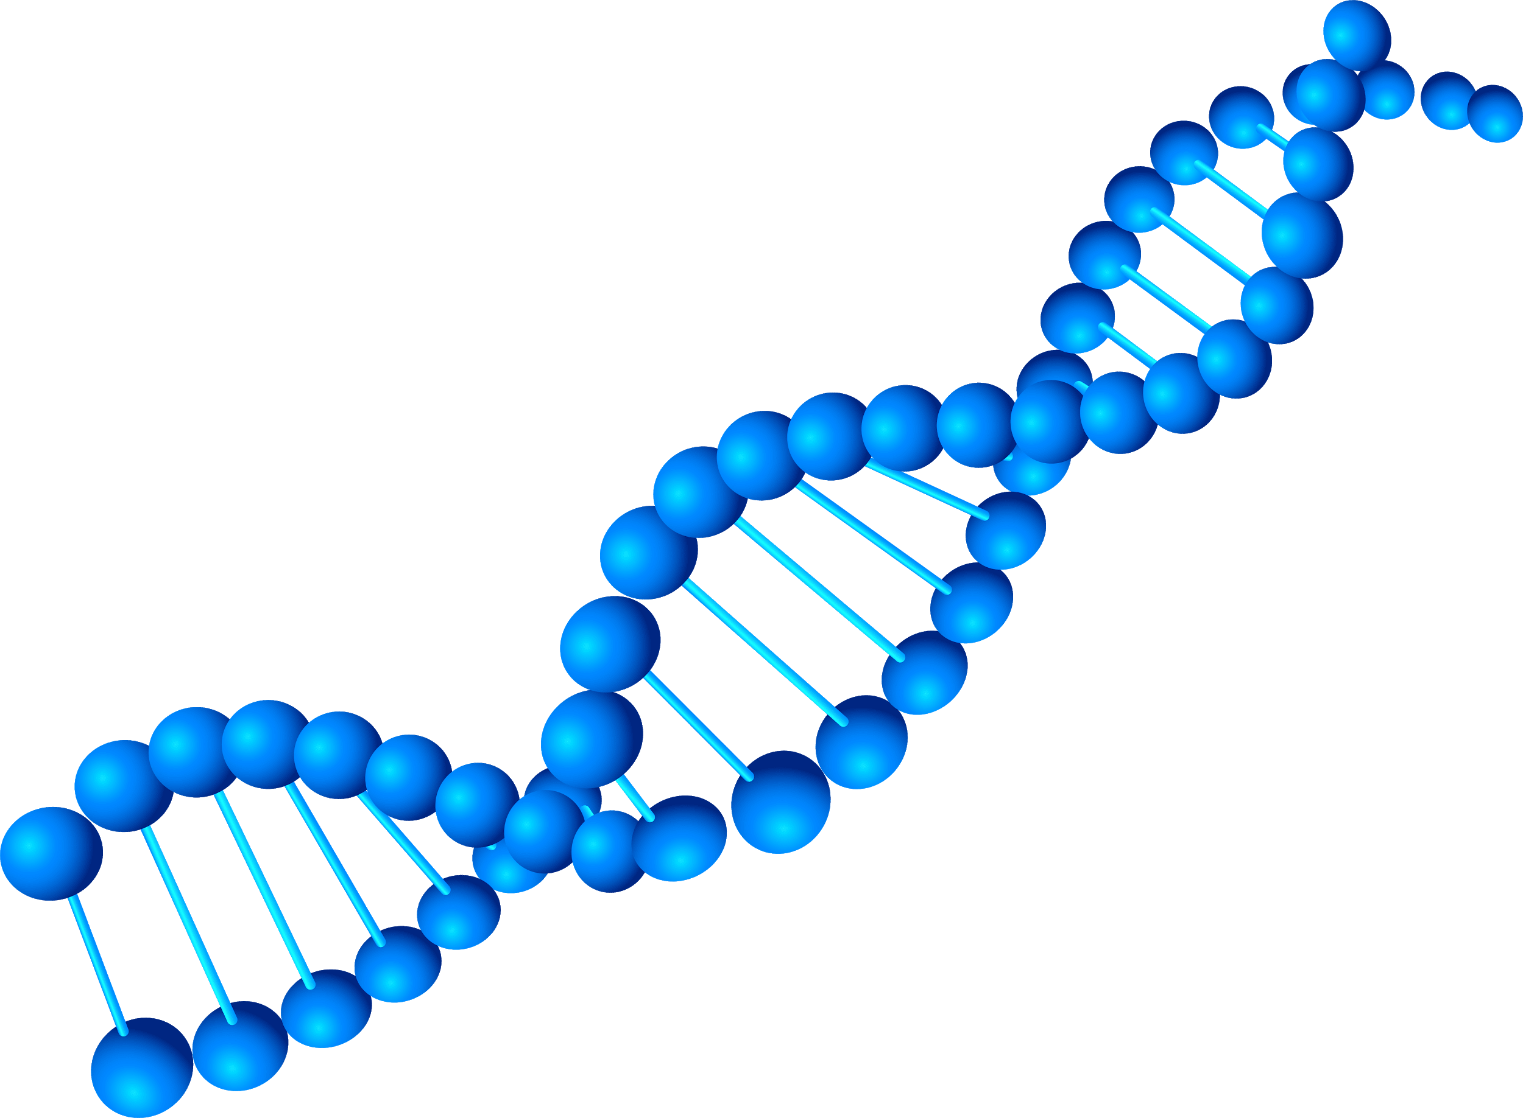

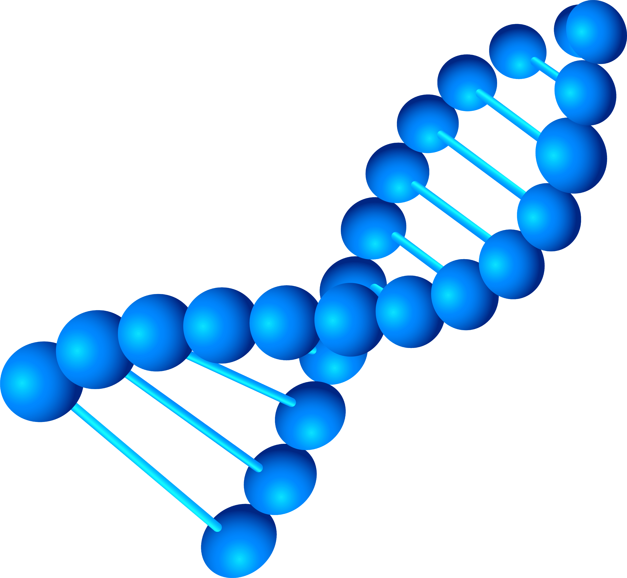
Chris Woodruff
@cwoodruff
cwoodruff@live.com

Slide 4
Why use genetic algorithms
In computer science an optimization problem is to find the best of all possible or available solutions for a given problem.

Slide 5
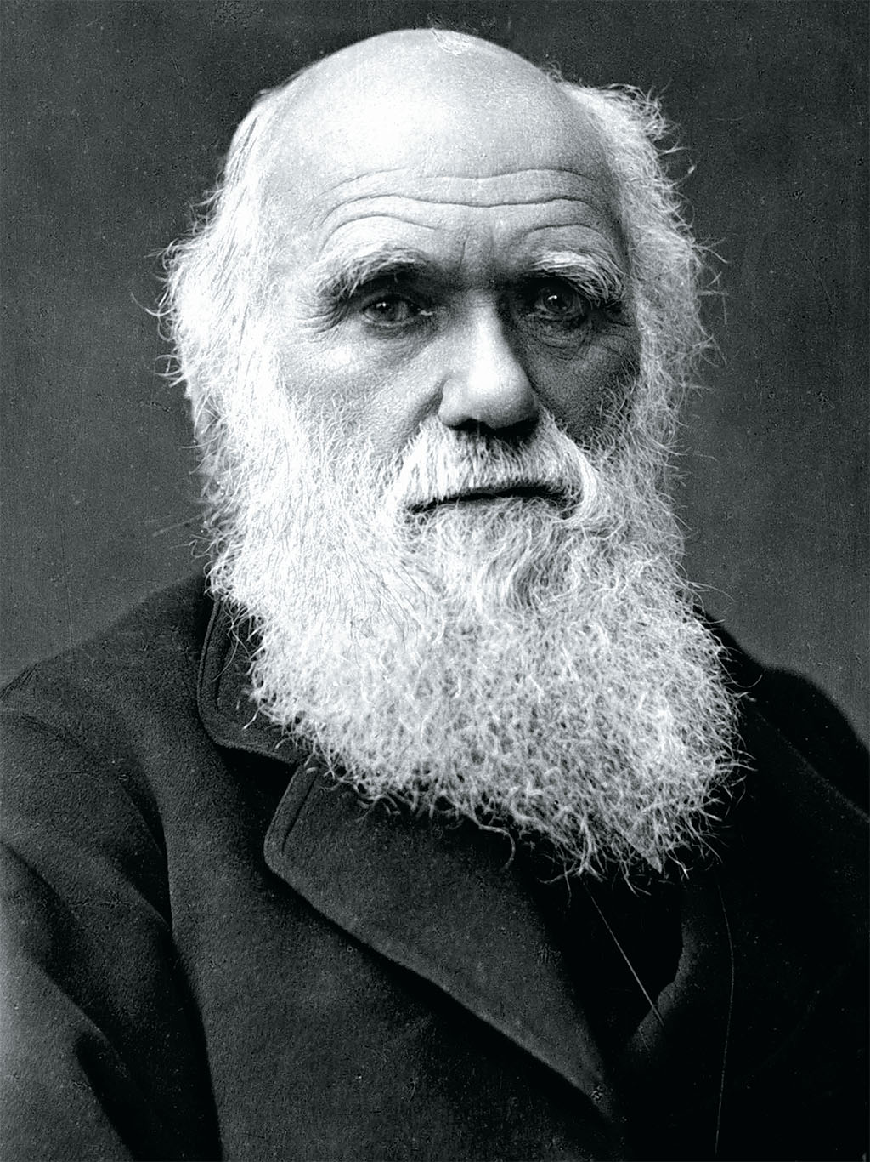
Where did Genetic Algorithms come from?
Evolutionary algorithms are based on biological processes and Darwinian evolution theory. Charles Darwin formulated the scientific theory of evolution by natural selection in his book 'On the Origin of Species', which was published in 1859.

Slide 6
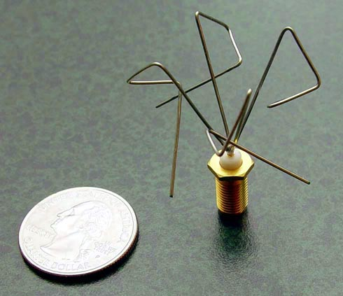
Problems solved by Genetic Algorithms
One example is the automatic design of antennas for radio communication. There is an infinite amount of possible shapes for antennas. In fact, the NASA used Genetic Algorithms to evolve an antenna design for its Space Technology 5 (ST5) mission which launched in March 2006.

Slide 7
EVOLUTION Overview
nucleus
chromosome
GENE
DNA
Core of a cell
DNA (DeoxyriboNucleic Acid) molecule
Small segment of this nucleotide sequence with a specific function
combination of many genes which encode different characteristics of an organism, for example its size, colour and gender

Slide 8
EVOLUTION Overview
population
Recombination / Crossover
Mutation
Natural Selection
A group of organisms, in which pairs of members can breed offspring (children)
When two organisms reproduce, their individual chromosomes / DNA will be copied, mixed up and passed on to their children
A few genes of the children will be changed by random chance
The children with the best fitness will survive and reproduce more than other children

Slide 9
TERMINOLOGY
Gene
Genome
Population
Selection
Crossover
Fitness Function
Generation
Smallest unit of information
Sequence of genes
Collection of individual DNAs
A new population of evolved DNA
Mutation
Objective function which calculates the score of a DNA
A strategy to select parent DNAs for reproduction based on their fitness
A strategy to copy genes from parent DNAs to create new child DNAs
A (random) change of one or more genes in a DNA

Slide 10
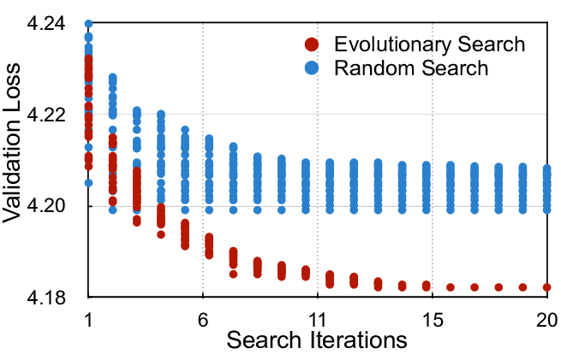
Quickly get to results

Slide 11
Limitations
Complexity
Complexity
Solution
Genetic algorithms do not scale well with complexity.
Finding the optimal fiction function can be expensive
the stop criterion is not clear in every problem

Slide 12
Selection

Slide 13
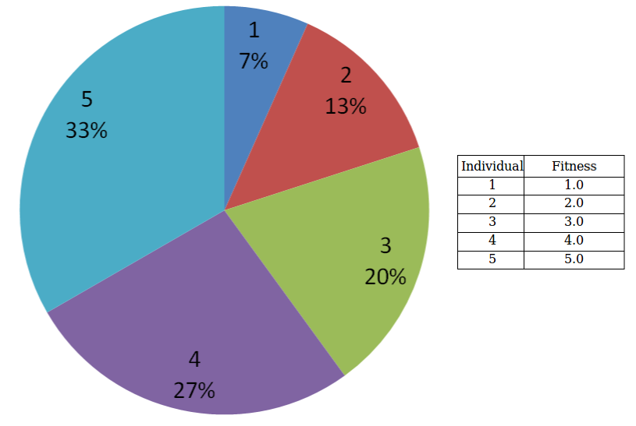
Roulette Selection

Slide 14
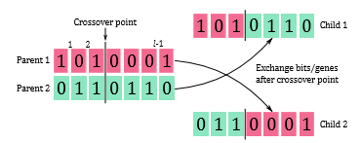
CROSSOVER

Slide 15
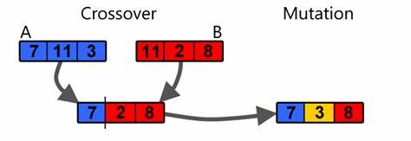
MUTATION

Slide 16


Slide 17
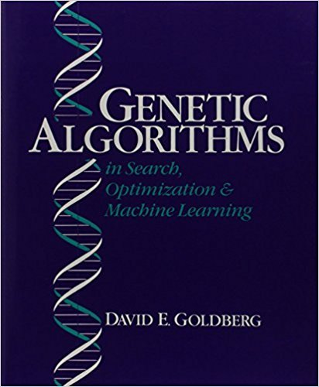

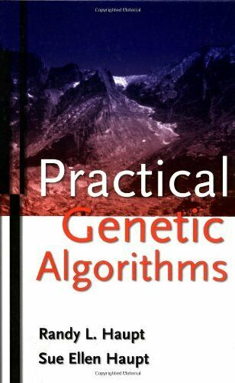
BOOKs and Resources
https://github.com/cwoodruff/genetic-algorithms
https://github.com/giacomelli/GeneticSharp

Slide 18
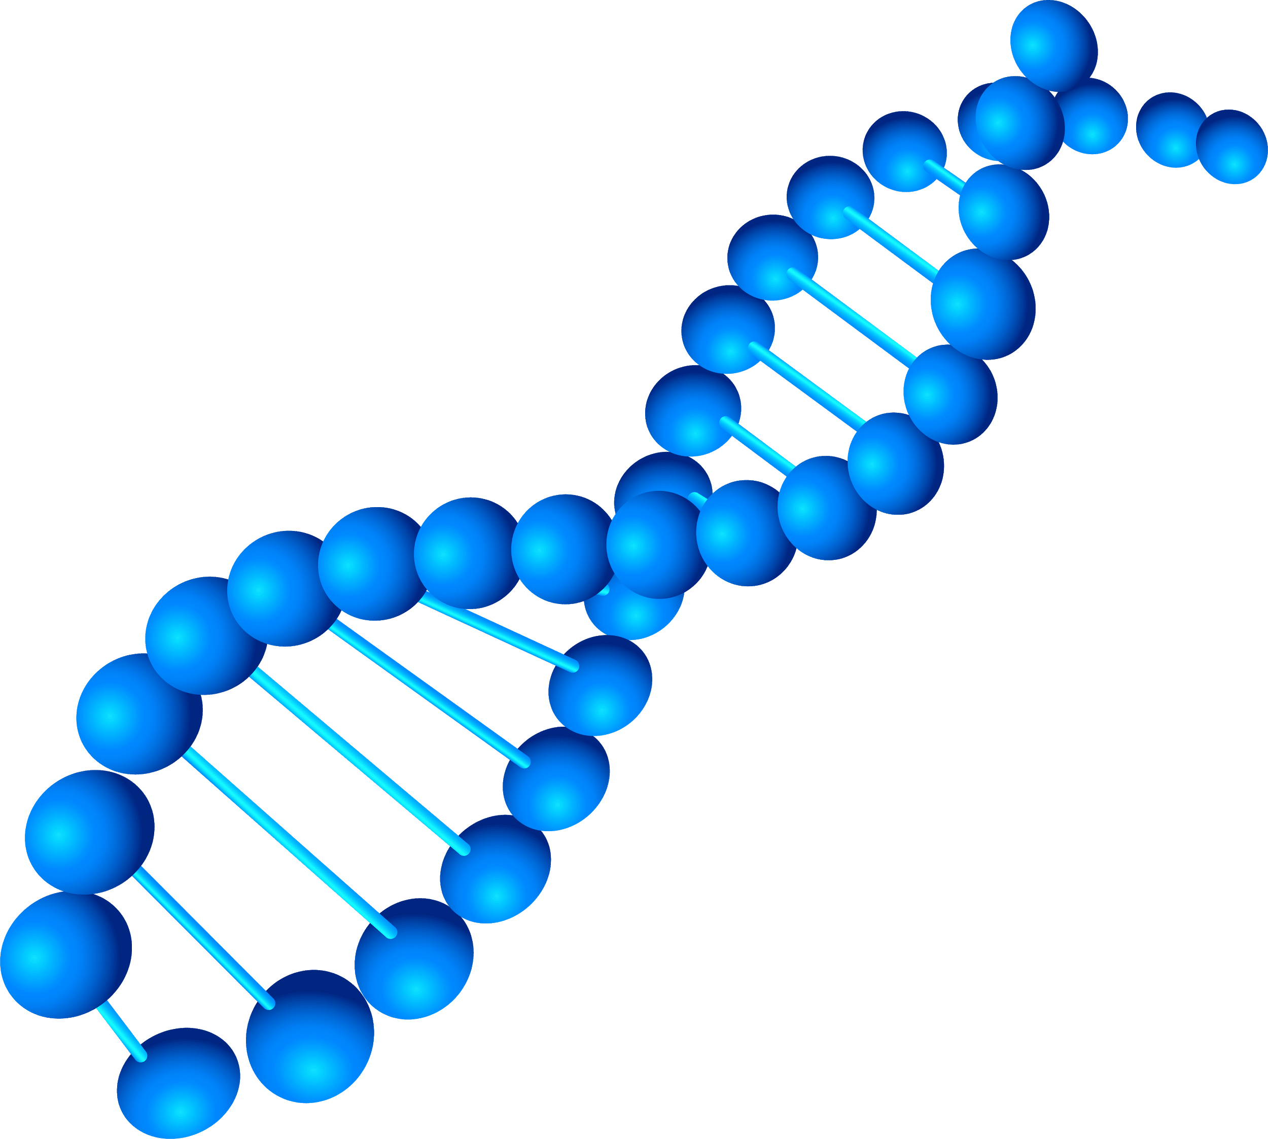
THANKS!
Do you have any questions? cwoodruff@live.com chriswoodruff.com

